Slide 1

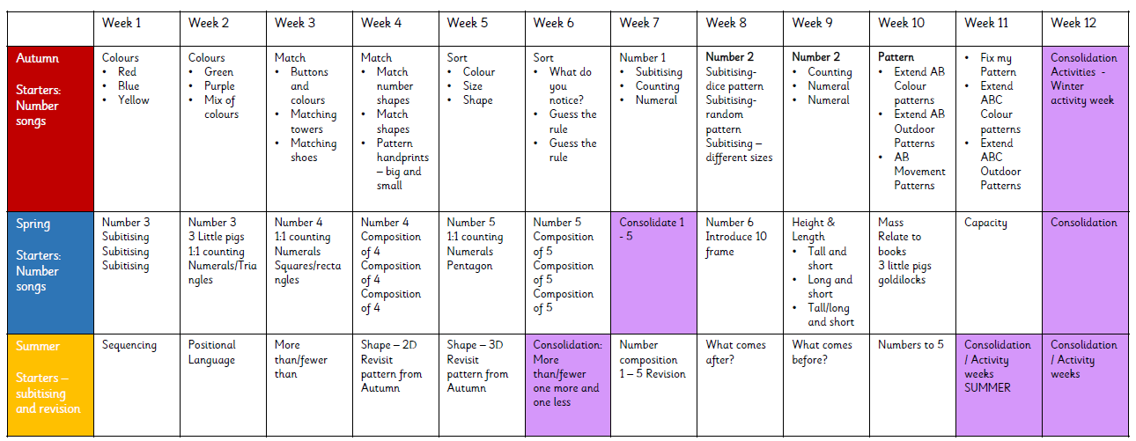
Nursery Long Term Plan

